Slide 1
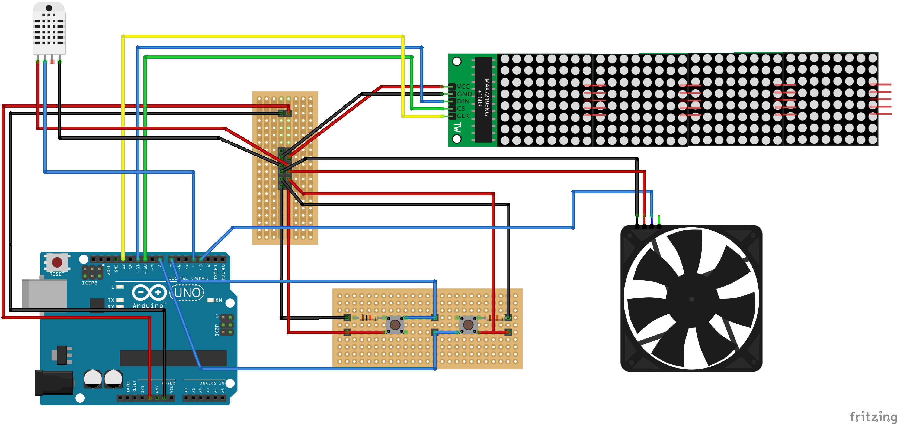
E
D
B
F
C
A

Slide 2
HIGH
0%
LOW
HIGH
50%
LOW
HIGH
100%
LOW

